Slide 1
ADVANCED DATA STRUCTURES
By
K. Govindaraju
Associate Professor
Dept. of Computer Science and Engineering
Aditya Engineering College(A)
Surampalem

Slide 2
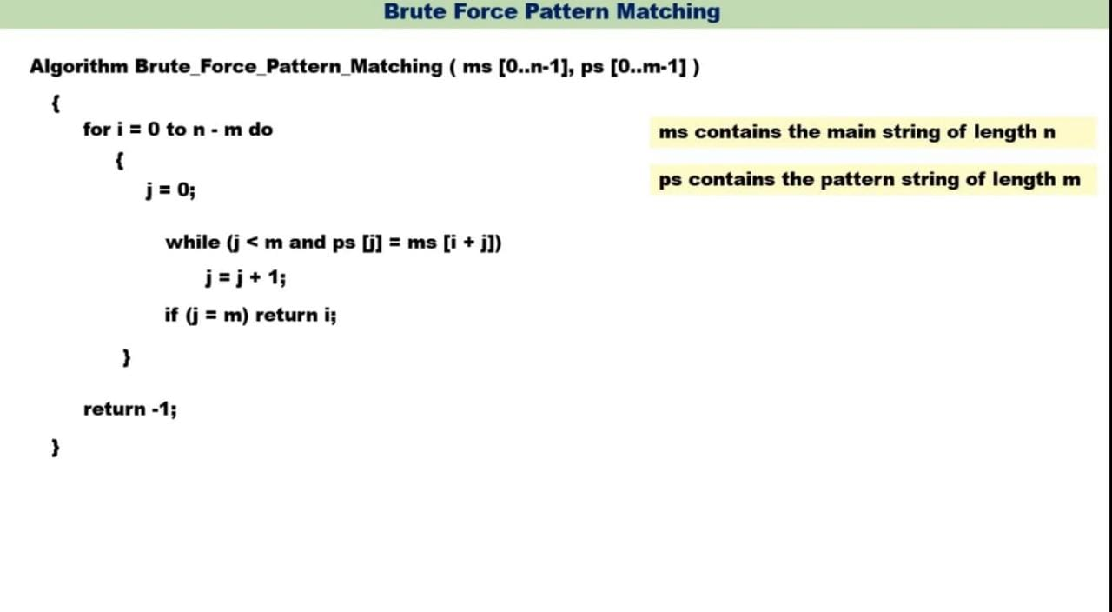
Brute Force Algorithm
228863
K. Govindaraju, Associate Professor

